Slide 1


Incedo System Monitor
Team Members
1. Pavitar Goyal
2. Ishika Bhatt
3. Nizamuddin Syed
4. Esha Sali
Mentors
1. Joy Asthana
2. Ashutosh Gupta
3. Ramkumar Lodhi

Slide 2
Contents
Problem Statement
Introduction
Block Diagram
Special Features
Demo
Future Scope

Slide 3



Problem Statement
The goal of the problem statement given to us was to fetch the System Information from the User’s System, measure and analyze the system information that is fetched and provide proper feedback to enhance a system’s performance.
Monitoring important systems is extremely important and a key component in order to achieve increased efficiency, stability and profitability over the network.
This can be achieved using a central monitoring system to gather data periodically and provide a consolidated analysis and meaningful interpretation of the system information.
This analysis helps to provide the user with :
Different methods for enhancing a system’s performance
Improves decision-making to enhance resource optimization through the examination of system information.
Additionally, it is beneficial to regularly review the system’s data and identify the anomalies as soon as possible to prevent any further problems/complications.

Slide 4
Introduction to the Project – System Monitor
We have implemented a central monitoring system using the client-server architecture, to gather system data from numerous nodes throughout a network.
The client periodically retrieves relevant data and transfers it across the TCP/IP network to a designated server.
In order to provide a server with an update on the system's status, the following parameters must be delivered periodically:
System Name
RAM Usage
CPU Utilization
System Idle Window
HDD Utilization
These parameters are then sent from the server to the database on a regular basis by establishing the database connection.
Furthermore, the GUI on the server side, which is integrated with the database, assists the user in retrieving specific information about a certain client and gaining insights into system information via various charts/graphs provided by the GUI.
Notes:
• Body Slide (Large text box)
• Goal: Provides ample text space for more detailed explanations.
• Required to Include: Header title; text; Incedo logo.
• Optionally include: Subheader.

Slide 5
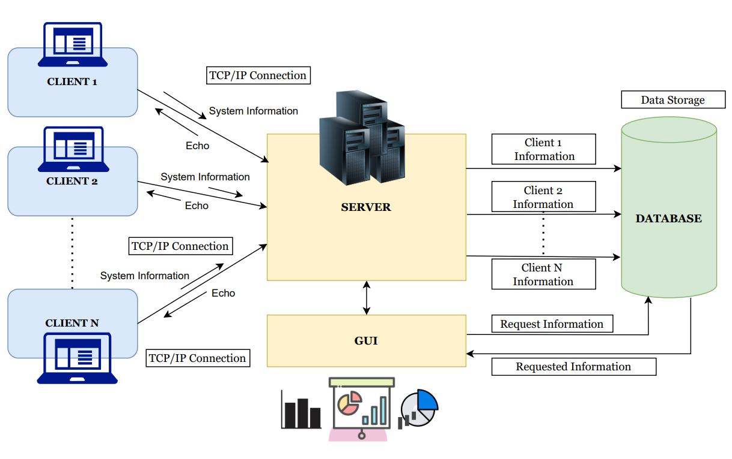
Block Diagram
Tools/ SDKs used:
Visual Studio Community Edition
C/C++ Programming constructs along with STL
MySQL
Socket Programming
CLI/C++ Toolset

Slide 6





Client Features
Basic Features
Special Features
Digital Business Transformation
Digital Operations Transformation
Client Server Connection using Socket Programming
System information data is sent in the form "json" to the server for easier accessing of information through key value pairs.
Fetching System Information and sending it to the Server
Exception handling is used to manage unexpected situations. Every exception displays a suitable message that is user-friendly and simple to comprehend.
Data is automatically transferred on a regular basis in a
single detached thread.
By entering "quit" in the console, the client can securely disconnect from the server and wipe up all of its associated resources. Additionally, it stops the periodic data-sending function.

Slide 7

Server Features
Basic Features
Special Features
Digital Business Transformation
Digital Operations Transformation
Server can handle multiple clients at the same time on a single thread by the use of select statement and master socket.
No two clients with the same username can join at the same time since the server keeps track of all connected clients.
The master socket is cleaned up and all resources associated with a disconnected client are eliminated so that server doesn't have to wait for that client's information.
Server is able to collect the information sent by the client in a json file.
In order to update necessary information, such as data received from clients, system information, connection status, etc., the server is connected to a database.
By typing “quit”, you can terminate the server, this will
shutdown all users who are connected and clear up all resources.
The server also features an echo functionality, allowing it
to send the data received from a client back to that specific
client.

Slide 8
Database Features
Basic Features
Special Features
Digital Business Transformation
Digital Operations Transformation
A successful connection is established between the
server and the database.
Additional queries that were added to retrieve important information are as follows:
Fetch all Data based on Client Name
All the incoming entries were successfully inserted into the database and the database was updated periodically.
Retrieve all information from a client's n most recent entries
Obtain max/ min Ram for a specific client
In the last n entries, which user has maximum free RAM, minimum CPU usage, and maximum disc space available

Slide 9
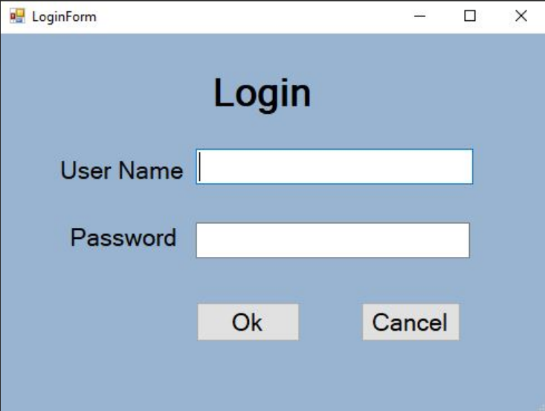
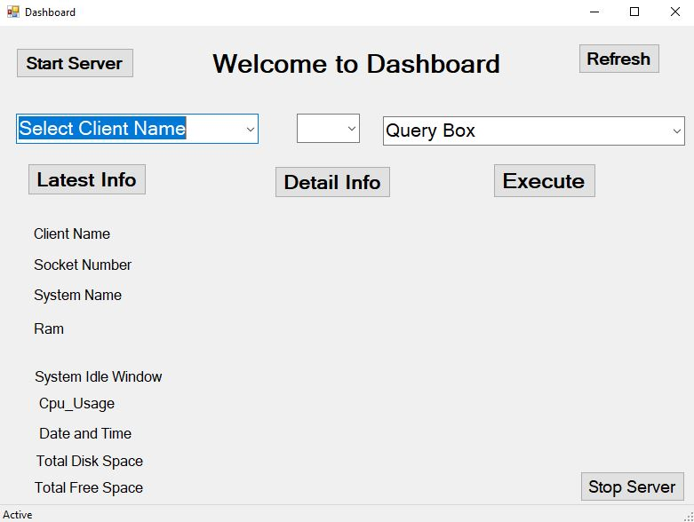
Special Features - UI
One has to log in using the login form in order to access the UI dashboard.
Digital Business Transformation
Dashboard offers a number of functionalities, including:-
Start and stop buttons to operate the server.
The combo-box list of client names is dynamically updated in real time.
The user can access the most recent entries of a selected client's data,
which is shown in charts and tables.
There is a special query field where users can enter specific queries,
such as the maximum and minimum amounts of RAM and CPU utilization.
With each query, the database connection is properly closed,
releasing resources and making the UI less bulky.
To provide a seamless, user-friendly experience, every button—whether on
the login form, dashboard-has exception handling.

Slide 10
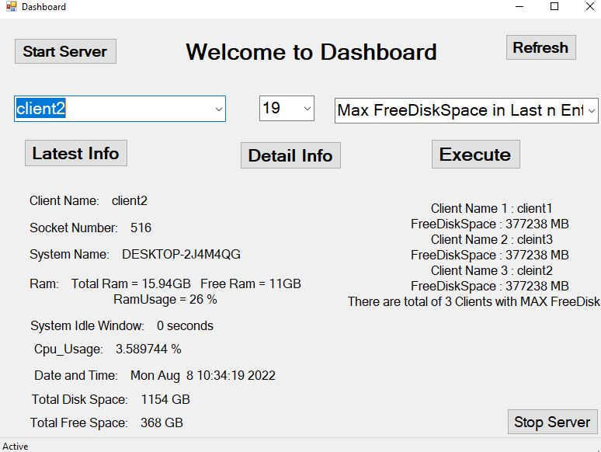
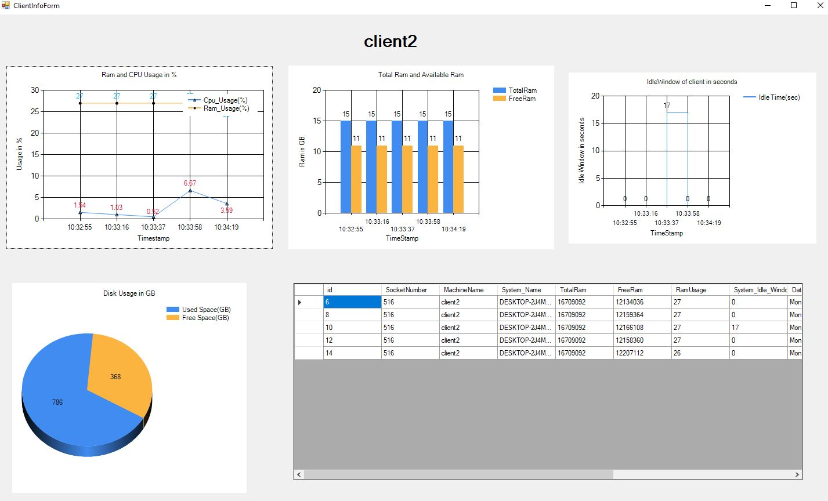
UI DASHBOARD
CLIENT INFORMATION

Slide 11
Demo

Slide 12

Future Scope
Our Project has covered almost all the basic requirements. Further features and improvements that can be added are as follows:
More Client Functionalities
On the client end, functionalities such as password authentication and ability to reconnect to server after terminating connection can be added.
Database Queries
Additional queries can be added to the database to retrieve crucial or required data
Configuration Functionality
The ability to configure new server accounts can be implemented in the server GUI.
Security Functions
Additional security features could be incorporated.
Future
Scope
Comprehensive Analytics
The structure of system information collected and delivered over the network can be further enhanced to include extensive analytics data to measure work-time, work-output, in-focus apps, real-time file-changes stats, screenshots, idle-windows, and so on.
UI
UI can be added on the client side too,
for easier communication
Data Archiving
We can use data archiving to identify the data that is no longer in use and move it from our database systems onto long-term storage systems so that it can always be put back into service if necessary. We can also build a functionality that deletes archived data on a regular basis.
Back-Up
In the case of a server crash, there can be a back up server that will handle all the operations.
Notes:
This can be used as a default slide for Incedo introduction.

Slide 13
QnA

Slide 14
Thank You!

